Slide 1
EdgeGallery-MECM
ETSI-MEC Alignment
Shashikanth, Gaurav

Slide 2
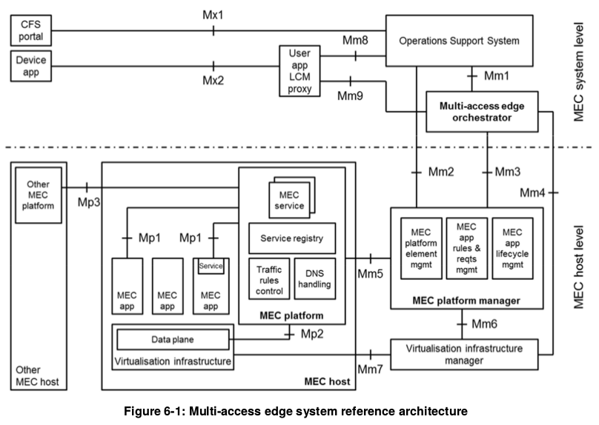
OSS
MEC Orchestrator
Maintenance view: Deployed host, available resources/services and topology
App package management, App repository
Host selection for app deployment
Initiate App instantiation or instance termination
App location migration
receives requests via the CFS portal and from device applications for instantiation or termination of applications
Granted requests are forwarded to the multi-access edge orchestrator for further processing.
receives requests from device applications for relocating applications between external clouds and the MEC system.
MEC Platform Manager
App instance lifecycle management, including status report to the MEO
MEP NE management, including NE and service deployment
Flow and DNS rule management, including rule setting receipe and distribution to each MEP
Virtual resource status, fault report and performance statistics collection for each MEC host
User APP LCM Proxy
allows device applications to request on-boarding, instantiation, termination of user applications
relocation of user applications in and out of the MEC system.
Informs the device applications about the state of the user applications.
Authorizes requests from device applications in the device and interacts with the OSS and the multi-access edge orchestrator for further processing of these requests.
MEC Platform
Provides services governance for apps(Release,discovery, subscription and consumption)
Receives flow rule settings and sends them to the data plane
Receive DNS policies and uses them in DNS services (service/proxy)
Monitors app integration and O&M status
Offer basic app services, including API GW capability exposure.
VIM
Allocating, managing and releasing virtualized resources
preparing the virtualization infrastructure to run a software image.
collecting and reporting performance and fault information about the virtualized resources;
when supported, performing application relocation.
Data Plane
MEC App
Provides Intermediate UPF
App flow scheduling and load balancing
Traffic redirection
Runs on containers/VM of MEC hosts
Interworks with the MEPM via Mp1 interface for lifecycle, flow rule management and service governance
Provides services for other APPs
Access MEC services

Slide 3
ETSI MEC API summary
Mm4 Reference Point
manage virtualized resources of the MEC host, including keeping track of available resource capacity
manage application images.
Mm1 Reference Point
App Package mgmt
On boarding
Search, delete, enable, disable
App Life cycle mgmt
App Instantiation
Termination
Status change
Mm5 Reference Point
Perform platform configuration
Configuration of the application rules and requirements
Performs application lifecycle support procedures
Mm2 Reference Point
Mm6 Reference Point
Mgmt data model definition
Data model, data retrieval from MEPM
Data model change notice to the OSS
Traffic distribution rule addition, activation or deactivation
DNS rule addition, activation, or deactivation
Fault management.
Manage virtualized resource to realize the application lifecycle management.
Mm7 Reference Point
Manage the virtualization infrastructure inside MEC host.
Mm3 Reference Point
App Package mgmt
App package data requesting
App package change notice
App pkg on-boarding notice
App pkg retrieval
App Life cycle mgmt (MEO->MEPM)
App instantiation and termination
App instance status change
Status request
(MEO->MEPM)
App lifecycle change notice
There are three groups of reference points defined between the system entities:
• reference points regarding the MEC platform functionality (Mp);
• management reference points (Mm); and
• reference points connecting to external entities (Mx).
Mm8 Reference Point
Handle device applications requests for running applications in the MEC system.
ETSI Standard Available
VIM Specific API
Mm9 Reference Point
Manage MEC applications requested by device application.
ETSI Standard Not Available
Out of Scope/
Future Study

Slide 4
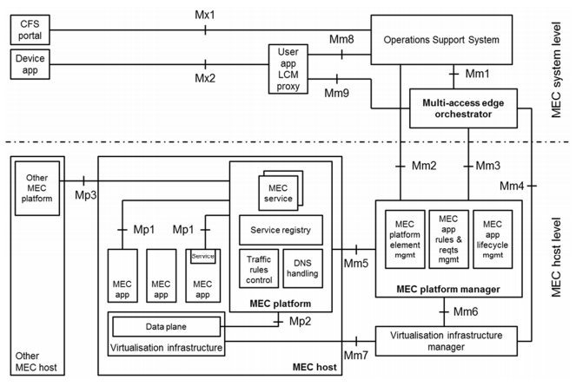
EdgeGallery Architecture Alignment with ETSI MEC (Management Part)
OSS
Management
AppO
APM
Common Services
MEO
Platform Manager
Security Services
Inventory
Logging
Infra Manager
Placement
Policy
DB etc.
MEPM
MEPM
AppLCM
AppRules
Element management
APPLCM
Rules Mgmt
Element Mgmt
LCM Controller
K8s plugin
Future plugin
VIM
K8s/Future VIM

Slide 5
EdgeGallery API Alignment with ETSI MEC Summary (Management Part)
OSS
Application LCM
Application Package Management
Application LCM
Application PkgM
Management
MM1
AppO
APM
Common Services
MEO
Platform Manager
Security Services
MM2
Configuration Mgmt
Fault Mgmt
Inventory
Logging
Infra Manager
Placement
Policy
DB etc.
Application LCM
Application PkgM
Application Lccn
MM3
MM4
Application LCM
MEPM
MM5
Config Mgmt
Rules Mgmt
AppLCM Support
MEPM
AppLCM
AppRules
Element management
APPLCM
Rules Mgmt
Element Mgmt
LCM Controller
Towards MEP
K8s plugin
Future plugin
MM6
Virtualized Resource Mgmt
Resource Monitoring
Image Management
Virtualized Resource Mgmt
Resource Monitoring
Image Management
VIM
K8s/Future VIM

Slide 6
EdgeGallery API Alignment with ETSI MEC: MM1 Details
Mm1 | APM Functional requirement description | Mm1 | LCM Functional requirement description
AppPkgm.001 | APM interface produced by the MEO on the Mm1 reference point shall support on-boarding an Application Package. | AppLcm.001 | The Application Lifecycle Management interface produced by the MEO on the Mm1 reference point shall support instantiating an Application instance.
AppPkgm.002 | APM interface produced by the MEO on the Mm1 reference point shall support querying Application Package information | AppLcm.002 | The Application Lifecycle Management interface produced by the MEO on the Mm1 reference point shall support terminating an Application instance.
AppPkgm.003 | APM interface produced by the MEO on the Mm1 reference point shall support deleting an Application Package. | AppLcm.003 | The Application Lifecycle Management interface produced by the MEO on the Mm1 reference point shall support requesting to change the state of an application instance (see note).
AppPkgm.004 | APM interface produced by the MEO on the Mm1 reference point shall support enabling an application package. | AppLcm.004 | The Application Lifecycle Management interface produced by the MEO on the Mm1 reference point shall support providing notifications as a result of lcm operations.
AppPkgm.005 | APM interface produced by the MEO on the Mm1 reference point shall support disabling an application package.
AppPkgm.006 | APM interface produced by the MEO on the Mm1 reference point shall support providing notifications as a result of changes on application package states.
AppPkgm.007 | APM interface produced by the MEO on the Mm1 reference point shall support providing notifications about the on-boarding of application packages
AppPkgm.008 | APM interface produced by the MEO on the Mm1 reference point shall support fetching an application package, or selected files contained in a package.
EG MECM need to Align with ETSI
Not Implemented

Slide 7
EdgeGallery API Alignment with ETSI MEC: MM3 Details
Mm3 | APM Functional requirement description | Mm3 | LCM Functional requirement description
AppPkgm.001 | APM interface produced by the MEO on the Mm3 reference point shall support querying application package information | AppLcm.001 | The Application Lifecycle Management interface produced by the MEC Platform Manager on the Mm3 reference point shall support instantiating an Application.
AppPkgm.002 | APM interface produced by the MEO on the Mm3 reference point shall support providing notifications as a result of changes on application package states. | AppLcm.002 | The Application Lifecycle Management interface produced by the MEC Platform Manager on the Mm3 reference point shall support terminating an application instance.
AppPkgm.003 | APM interface produced by the MEO on the Mm3 reference point shall support providing notifications about the on-boarding of application packages. | AppLcm.003 | The Application Lifecycle Management interface produced by the MEC Platform Manager on the Mm3 reference point shall support querying information about an application instance.
AppPkgm.004 | APM interface produced by the MEO on the Mm3 reference point shall support fetching an application package, or selected files contained in a package. | AppLcm.004 | The Application Lifecycle Management interface produced by the MEC Platform Manager on the Mm3 reference point shall support requesting to change the state of an application instance
AppLccn.001 | The Application Lifecycle Change Notification interface produced by the MEC Platform Manager on the Mm3 reference point shall support providing to the MEO notifications about changes of an application instance that are related to application lifecycle management operations. | AppLcm.005 | The Application Lifecycle Management interface produced by the MEC Platform Manager on the Mm3 reference point shall support querying the status of an ongoing application lifecycle management operation.
AppLccn.002 | Notifications provided on the Application Lifecycle Change Notification interface produced by the MEC Platform Manager on the Mm3 reference point shall contain information about the type of application lifecycle operation, the identification of the application instance | AppLccn.004 | The Application Lifecycle Change Notification interface produced by the MEC Platform Manager on the Mm3 reference point shall support notifying the result (successful or failed) of application instantiation with indicating the application instance identifier, and the consumed, modified or released resources.
AppLccn.003 | Notifications provided on the Application Lifecycle Change Notification interface produced by the MEC Platform Manager on the Mm3 reference point shall support indicating the start of the lifecycle operation, the end and the results of the lifecycle operation including any error produced from the lifecycle operation.
EG MECM need to Align with ETSI
Not Implemented

Slide 8
EdgeGallery API Alignment with ETSI MEC: MM2 Details
Mm2 | Functional requirement description | Mm2 | Functional requirement description
MEA-CM-1 | The Mm2 reference point shall support a capability allowing the OSS to create managed object instances representing mobile edge application instances in the mobile edge platform manager. | MEH-CM-1 | The Mm2 reference point shall support a capability allowing the OSS to retrieve the information model of the mobile edge host, or parts thereof, from the mobile edge platform manager.
MEA-CM-2 | The Mm2 reference point shall support a capability allowing the OSS to delete managed object instances representing mobile edge application instances in the mobile edge platform manager. | MEH-CM-2 | The Mm2 reference point shall support a capability allowing the mobile edge platform manager to notify changes related to the information model of the mobile edge host to the OSS.
MEA-CM3: | The Mm2 reference point shall support a capability allowing the OSS to activate and deactivate the DNS rules related to a certain mobile edge application instance. | MEH-CM-3 | The Mm2 reference point shall support a capability allowing the OSS to configure the mobile edge host.
MEA-CM-4 | The Mm2 reference point shall support a capability allowing the OSS to activate and deactivate the traffic rules related to a certain mobile edge application instance. | MEH-CM-4 | The Mm2 reference point shall support a capability allowing the OSS to configure the DNS rules.
MEA-CM-5 | The Mm2 reference point shall support a capability allowing the mobile edge platform manager to notify changes of managed object instances representing mobile edge application instances to the OSS. | MEH-CM-5 | The Mm2 reference point shall support a capability allowing the OSS to configure the traffic rules.
MEA-CM-6 | The Mm2 reference point shall support a capability allowing the mobile edge platform manager to notify object creation and deletion events of managed object instances representing mobile edge application instances to the OSS. | MEH-FM-1 | The Mm2 reference point shall support a capability allowing the mobile edge platform manager to send mobile edge platform related alarms to the OSS.
MEA-SM-1 | The Mm2 reference point shall support a capability allowing the mobile edge platform manager to expose the operational state of instantiated mobile edge applications to the OSS. | MEH-FM-2 | The Mm2 reference point shall support a capability allowing the OSS to retrieve and manage alarms from the mobile edge platform manager.
Not Implemented

Slide 9
EdgeGallery Flow Alignment with ETSI MEC
EdgeGallery Existing Flow
Application package management
Application package management
OSS
MEO
MEPM
INFRA
OSS
APM
INFRA
OnBoard app Pkg
OnBoard app Pkg
appPkgId, appDId
validate
App pkg id
App pkg Onboard Notification
Create AppPackage info
Fetch app pkg
Upload application image to edge
Upload application image to edge
Query app pkg info
Query app pkg info
Query app pkg info
app pkg info
This flow can be used by the MEPM to obtain the application requirements, traffic redirection rules and DNS rules that it needs to configure the MEC platform to run the application.
app pkg info
Disable/Enable app package
AppPackageState
ChangeNotification
Delete app package
Delete application image from edge
Delete appPkg
Delete AppPackage info
AppPackageState
ChangeNotification
Not Implemented

Slide 10
EdgeGallery LCM Flow Alignment with ETSI MEC
EdgeGallery Existing LCM Flow
OSS
MEO
MEPM
INFRA
OSS
MEO
MEPM
APM
INFRA
Create identifier
Create identifier
Create identifier
Create AppInstance
info
Create AppInstance info
App instance id
AppInstanceIdentifierCreationNotification
Download application package
App instance id
App instance id
Instantiate app
Instantiate app
lifecycleOperationOccurrenceId
Instantiate app
lifecycleOperationOccurrenceId
Instantiate app
Start,Lifecycle
ChangeNotification
Deploy and start application
Start,Lifecycle
ChangeNotification
Grant request
Query App pkg info
Deploy
result,Lifecycle
ChangeNotification
result,Lifecycle
ChangeNotification
Query app instance
Change app instance operation state
Change app instance operation state
Query app instance
lifecycleOperationOccurrenceId
Get application status
lifecycleOperationOccurrenceId
Start,Lifecycle
ChangeNotification
Start,Lifecycle
ChangeNotification
start/stop app instance
result,Lifecycle
ChangeNotification
result,Lifecycle
ChangeNotification
Terminate app Instance
Query app instance info
Terminate app Instance
Query app instance info
unDeploy application instance
appInstanceInfo
appInstanceInfo
Delete AppInstance info

Slide 11
EdgeGallery LCM Flow Alignment with ETSI MEC cont..
OSS
MEO
MEPM
INFRA
Query LCM oper status
lifecycleOperationOccurrenceId
Query LCM oper status
PROCESSING,
SUCCESSFULL_DONE, FAILED
operationStatus
operationStatus
Terminate app inst
Terminate app inst
lifecycleOperationOccurrenceId
lifecycleOperationOccurrenceId
Terminate and release resource
Delete identifier
Delete identifier
Delete AppInstance
info
AppInstanceIdentifier
Deletion Notification
AppInstanceIdentifier
Deletion Notification
Not Implemented

Slide 12
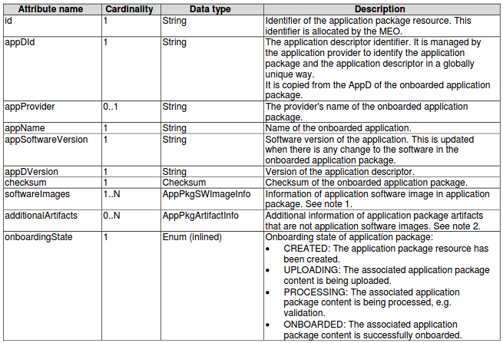
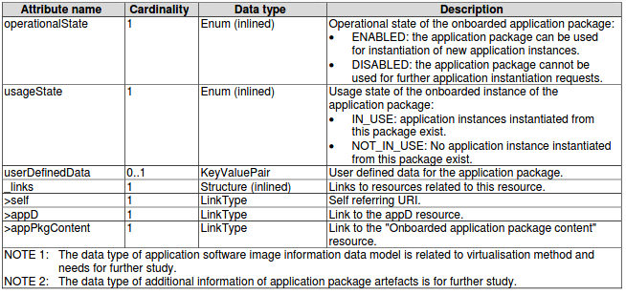
EdgeGallery Application package management information model Alignment with ETSI MEC
AppPkgInfo: The data type AppPkgInfo represents the parameters for an
application package resource
EdgeGallery Existing App package info
Attribute Name | Description
id | Unique id
app_pkg_id | Application package id
app_pkg_name | Application pkg name
app_pkg_version | Application pkg version
app_pkg_path | Application package path
app_provider | Application provider
app_pkg_desc | Application pkg descriptor
app_pkg_affinity | Application pkg affinity
app_icon_url | Application icon url
app_id | Application id

Slide 13
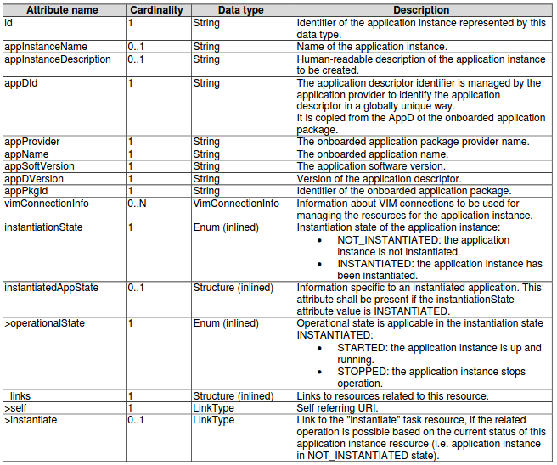
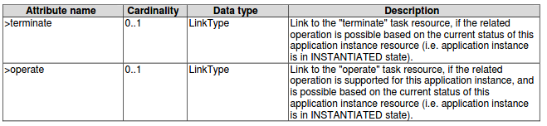
EdgeGallery Application lifecycle management information model Alignment with ETSI MEC
AppInstanceInfo: The data type of AppInstanceInfo represents
the parameters of instantiated application instance resources.
EdgeGallery Existing App Instance info
Attribute Name | Description
app_instance_id | Application inst id
app_package_id | Application pkg id
app_id | Application id
tenant | Tenant id
app_name | Application name
app_descriptor | Application descriptor
mec_host | MEC host
applcm_host | Applcm host
operational_status | Operational status
operation_info | Operations info

Slide 14
EdgeGallery ETSI-MEC Alignment Strategy (Management Plane)
MM1 Alignment including related flows and information model
MM2/MM3 - Depending on Partners/Community Interest
Phase 1
Phase 3
Phase 2
Rules Mgmt Module Addition MM5 Enhancement - Addition of AppLCM Support & Rules Management

Slide 15
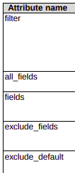
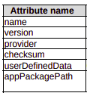




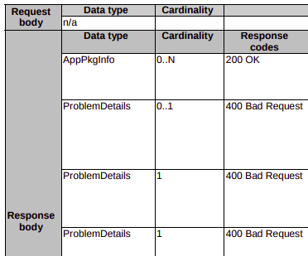

Requests
Application Package Management API (Mm1)
Onboarding operation
Enable operation
Disable operation
Delete operation
Query operation
MEC009v010101p
Response
No output parameter.
No output parameter.
No output parameter.
EG MECM need to Align with ETSI
Not Implemented

Slide 16
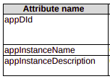
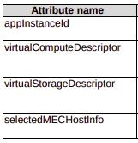

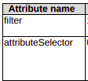





Requests
Application Lifecycle management API (Mm1)
Create
Identifier
Instantiate
Oper state change
Query app inst info
Query Lcm Oper states
Response
EG MECM need to Align with ETSI
Not Implemented

Slide 17










Requests
Application Lifecycle management API (Mm1)
Terminate
Delete identifier
Subscribe
Query subscription
Delete subscription
No input
Response
No output parameter.
No output parameter.
Notify
EG MECM need to Align with ETSI
Not Implemented

Slide 18
Thank you

